Slide 1
2023 Investment Highlights
3rd Quarter ending June 30, 2023
County Auditor’s Office
Commissioners Court Meeting

Slide 2
Quarterly Investment Update
Directly linked to the County Strategic Plan
    Investment Goals:
      Goal 1 - Investing funds on the principles of
      1. Safety
      2. Liquidity
      3. Diversification
      Goal 2 - Return on Investment

Slide 3
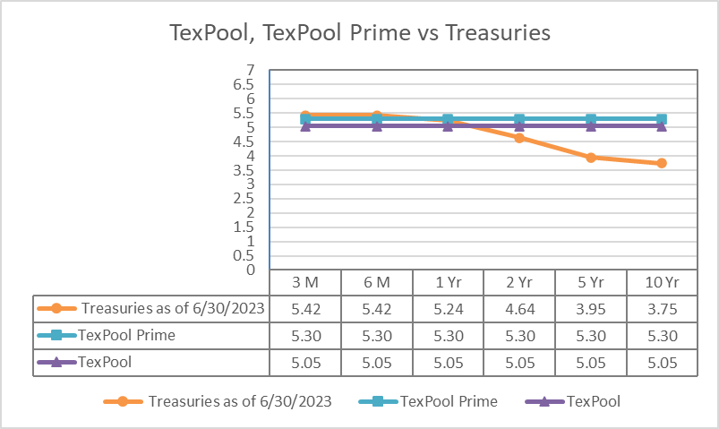
Quarterly Investment Update
Rate Comparison
Notes:
Treasury rates are beating the TexPool and TexPool Prime rates for the 90 day, and 6 month.
TexPool Prime is beating the Treasury rates for the 1 year, 2 year, 5 year, and 10 year
TexPool is beating the Treasury rates for the 2 year, 5 year, and 10 year

Slide 4
Quarterly Investment Update
Although investment vehicles have remained the same for both years (cash, TexPool, and TexPool Prime) the percentages in each have changed. As of June 31, 2023, the percentages in cash, TexPool, and TexPool Prime were 9.20%, 8.79%, and 82.01%, respectively. The June 30, 2022, percentages in cash, TexPool, and TexPool Prime were 17.20%, 15.30% and 67.51%, respectively.
Total investments were $501,415,494 for June 2023 compared to prior year of $391,810,626, an increase of $109,604,868, of which $109.1 million is from the ARPA funds.
The interest earned this fiscal year was $13,701,005 compared to last year of $1,125,998 an increase of $12,575,007 or 1,116.79%, which is mainly due to the change in investment mix, higher investible balances and higher interest rates.
Notes:
Of the $109.1 million ARPA grant funds, $39.5 million is invested in TexPool, $69.5 million in TexPool Prime. The remaining $141,703 million is in cash.

Slide 5
Quarterly Investment Update
Historical Market Environment
Key Interest Rates Averaged for the 12 Month period (averaged over five years)
Ten Year Treasury | 2.16%
Five Year Treasury | 1.95%
Two Year Treasury | 1.86%
TexPool | 1.54%
TexPool Prime | 1.70%
Vantage Bank | 0.54%
The fiscal year began with the overnight fed funds target range at 3.00% to 3.25%. In November 2022, the Federal Reserve raised the fed funds by 0.75%, again by 0.50% in December 2022 and by 0.25% each in February, March and May 2023. The Federal Reserve Committee decided to maintain the target range in June 2023 at 5.00% to 5.25%. Holding the target range steady allows the Committee to assess additional information to help them return inflation to 2 percent over time.
Notes:
These rates are based on a five-year average rate for each type of security.
The Federal Reserve:
On September 22, 2022, Federal Reserve meeting, the Committee decided to raise the target range by 75 basis points to 3.00-3.25%, which is the rate for the start of the fiscal year.
On November 3, 2022, Federal Reserve meeting, the Committee decided to raise the target range by 75 basis points to 3.75-4.00%
On December 15, 2022, Federal Reserve meeting, the Committee decided to raise the target range by 50 basis points to 4.25-4.50%
On February 2, 2023, Federal Reserve meeting, the Committee decided to raise the target range by 25 basis points to 4.50-4.75%
On March 23, 2023, Federal Reserve meeting, the Committee decided to raise the target range by 25 basis points to 4.75-5.00%
On May 4, 2023, Federal Reserve meeting, the Committee decided to raise the target range by 25 basis points to 5.00-5.25%

Slide 6
Quarterly Investment Update
Yields for June 2023
Texas Class (not currently invested in) | 5.27%
TexPool Prime | 5.30%
TexPool | 5.05%
Vantage Bank | 3.08%
Above is a comparison of interest rates for the investment pools and Vantage Bank. The two highest yielding pools are TexPool Prime and Texas Class. Both contain Commercial Paper, respectively consisting of approximately 55.9 and 86.48 percent of each pool’s investments.
Notes:
As of June 30, 2023, the pool yield rates continue to increase. The County entered into a new contract with Vantage Bank with rates tied to the market, but they are still lower than other investments. As noted on the Maturity Slide, we are keeping a minimal amount in the bank to take advantage of higher rates.
Bank Interest Percentage breakdown as of June 2023:
$0.00 to $50 Million Effective Fed Funds Rate Minus 2.00% (for June: 3.08%)
$50,000,001 to $100 Million Effective Fed Funds Rate Minus 1.50% (for June: 3.58%)
$100,000,001 & Over Effective Fed Funds Rate Minus 1.00$ (for June: 4.08%)

Slide 7
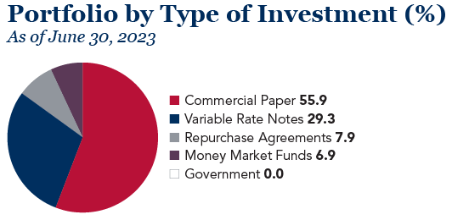
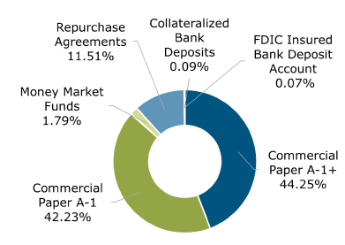
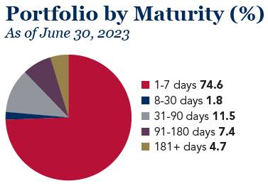
Quarterly Investment Update
Prime Investment Pools
Texpool Prime:
Texas Class:
Source: Texas Class Website – Portfolio Characteristics as of June 30, 2023
Source: TexPool July 1, 2023 Monthly Newsletter
Notes:
As of June 30, 2023, TexPool Prime contained 55.9% commercial paper compared to Texas Class which contained 86.48% commercial paper. The higher percentage of commercial paper in Texas Class makes it a riskier investment compared to TexPool Prime because of the amount of commercial paper held in the funds.

Slide 8
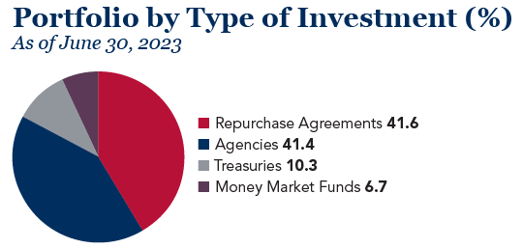
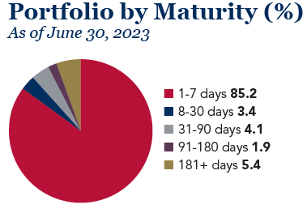
Quarterly Investment Update
TexPool
Source: TexPool July 1, 2023 Monthly Newsletter
Notes:
Texpool is very liquid and has low risk investment types

Slide 9
Quarterly Investment Update
The County had a weighted average yield of 5.1% as of June 30, 2023, compared to the 90-day treasury benchmark of 5.4% resulting in the County being 34.3 basis points below the benchmark for the month.
Notes:
This chart compares the portfolio’s monthly Weighted Average Yield (WAY) to the benchmark 90-day Treasury Bill Yield. Factors that impact the portfolio yield are the amount of cash in the bank. The portfolio’s WAY has increased by 402.59 basis points for June 2023 (5.0772%) when compared to June 2022 (1.0513%), due to increasing interest rates.

Slide 10
Quarterly Investment Update
The County’s investable funds include the General Fund, Special Revenue Fund, Capital Projects, Internal Service, Enterprise Fund, Debt Service, and Agency Fund.
Notes:
County funds peak and then decline through to mid December. On December 28, 2022, the general fund cash and investments reached its low point of $92,982,918 with TexPool, TexPool Prime and Munis general fund cash balances at $3,397,860, $87,134,139, and $2,450,919 or 3.65%, 93.71% and 2.64%, respectively. As funds were spent down during the quarter, the ratio of TexPool, TexPool Prime and cash changed with the cash ratio increasing and the TexPool, TexPool Prime ratios decreasing, until the County started receiving the bulk of Ad Valorem tax revenue on and after December 29, 2022.

Slide 11
Quarterly Investment Update
Date | Millions
October 31, 2022 | $103.2
November 30 | $97.9
December 31 | $154.5
January 31, 2023 | $194.4
February 28 | $223.2
March 31 | $194.8
April 30 | $183.0
May 31 | $178.9
June 30 | $150.2
Investable funds reach their lowest point in mid-December and increase from late December through mid-February.
After reaching its peak for investable funds in February, the general fund declines throughout the year until it reaches the low point in mid-December.
Notes:
Low Point for this fiscal year and last fiscal year:
FY2023: Dec 28, 2022 GF Total $92,982,918 GF TexPool: $3,397,860 GF TexPool Prime: $87,134,139 GF Cash Balance: $2,450,919
FY2022: Dec 21, 2021 GF Total $88,617,134 GF TexPool: $2,827,511 GF TexPool Prime: $22,126,039 GF Cash Balance: $63,663,584

Slide 12
Quarterly Investment Update
Date | Millions
October 31, 2022 | $9.0
November 30 | $10.5
December 31 | $22.2
January 31, 2023 | $31.3
February 28 | $7.1
March 31 | $7.1
April 30 | $7.2
May 31 | $7.2
June 30 | $7.2
Debt Service follows the same cash inflow pattern as the General Fund.
Disbursements occur in February, March, August, and September.
The low point for the debt service fund is September 16th the day after our final interest payment for the fiscal year is made.

Slide 13
Quarterly Investment Update
The primary funding sources for the Capital Projects Fund are bond proceeds and the two cents from the Maintenance and Operations portion of the Ad Valorem taxes which funds the Capital Improvement Fund.

Slide 14
Quarterly Investment Update
Investments by Fund Type as of June 30, 2023
Notes:
These fund balances include the cash and investment balances as of June 2023.

Slide 15
Questions

